Slide 1
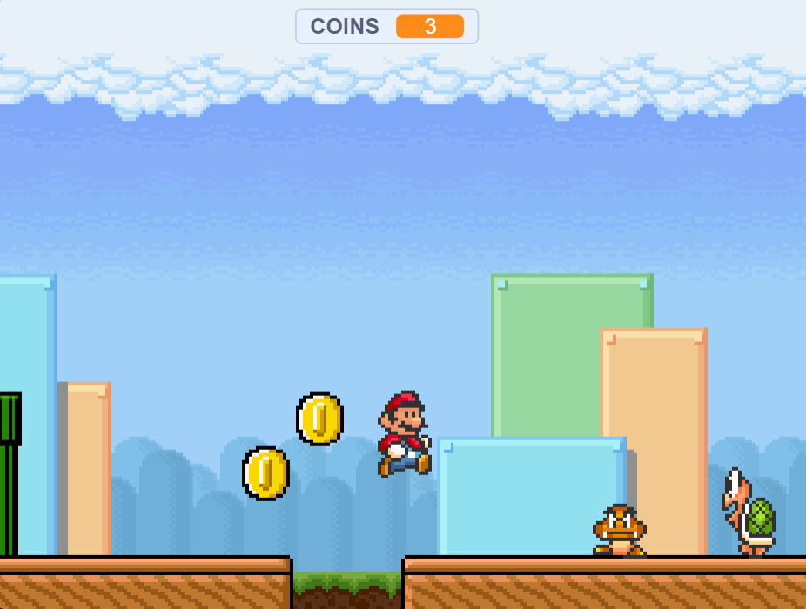
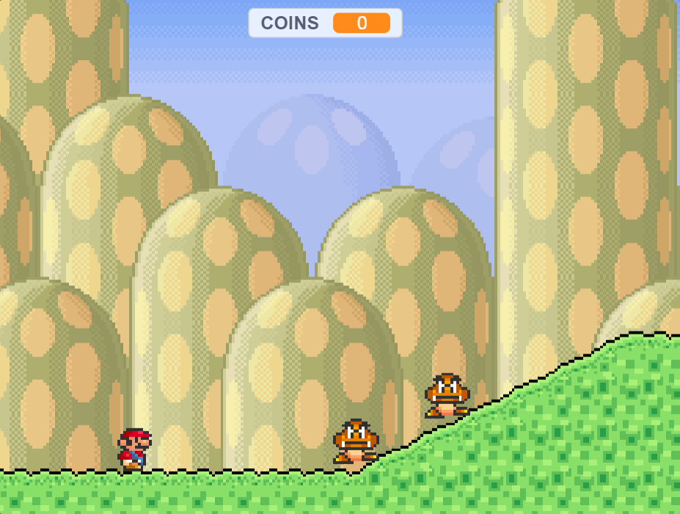

Slide 2
Itsumi Mario!
Help Mario in a dangerous adventure with many enemies and traps! Stop Bowser and save the mushroom kingdom from tragedy! Use Mario’s many powers to help you on your quest.

